Slide 1



IoT-Based Earth Leakage Monitoring System and alert staff in case of any malfunction
Team members:
Iyyappan M -927622BEC077
Jeeva A -927622BEC082
Kishore kumar A R -927622BEC101
Mohammed Rishwan S -927622BEC120
Guided by:
Mr.T.Sivakumar,
Assistant professor.

Slide 2
INTRODUCTION :
The system ensures electrical safety by monitoring current leakage.
Uses IoT to log, display , and alert about abnormal leakage.
Automatically disconnects load if leakage exceeds safety limits.
Provides real-time alerts to prevent electrical hazards .
18ECP107L- PROJECT WORK - END SEMESTER REVIEW PRESENTATION

Slide 3
ABSTRACT:
The IoT-Based Earth Leakage Monitoring System represents a significant advancement in ensuring electrical safety by leveraging modern IoT technologies and real-time monitoring capabilities. Electrical leakage, which occurs when current deviates from its intended path, can lead to serious consequences such as electric shocks, equipment damage, or even fires. Traditional systems, such as Earth Leakage Circuit Breakers (ELCBs), are reactive in nature, requiring manual intervention and lacking the ability to provide proactive insights or remote notifications. This system addresses these limitations by employing an ESP8266 microcontroller for both control and IoT connectivity.

Slide 4
OBJECTIVE:
To monitor earth leakage currents in a real time .
Trigger warnings and disconnect the load during abnormalities.
Ensure electrical saftely with IoT – enabled monitoring

Slide 5
FEATURES:
Auto-load disconnection when leakge exceeds safe levels.
Alerts through LEDs and a buzzer.
Real-time leakage monitoring.
IoT-based data logging and remote monitoring .
18ECP107L- PROJECT WORK - END SEMESTER REVIEW PRESENTATION

Slide 6
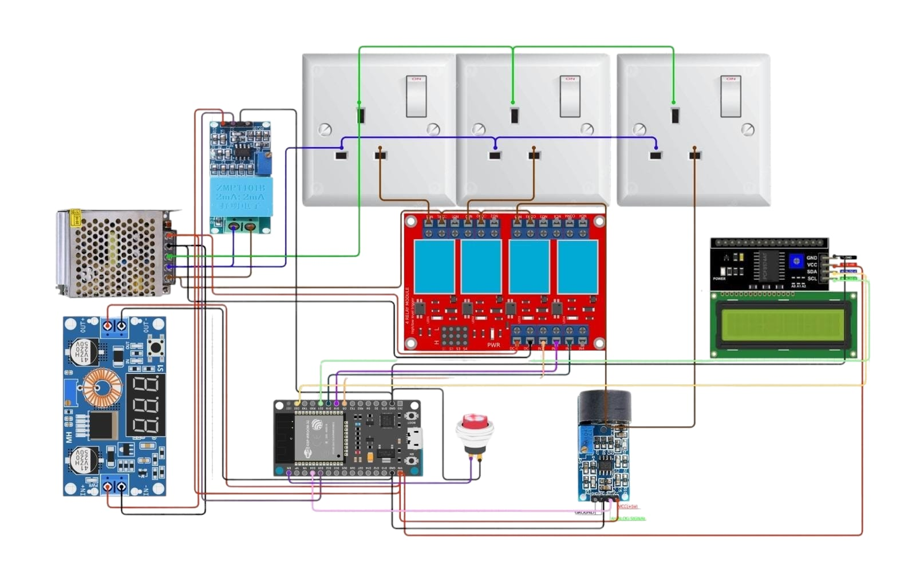
BLOCK DIAGRAM :

Slide 7
COMPONENTS :
Main Components:
1. ESP8266: IoT microcontroller.
2. CT Coil Module: Measures AC current.
3. Relay Module: Disconnects load.
4. LEDs & Buzzer: For alerts.
Supporting Items:
1. Wires, jumper wires, cardboard, ice sticks, CFL bulbs, bulb holders.

Slide 8
Working Principle:
Detection: The earth leakage sensor monitors the current flow continuously. If it detects a current flow to the ground above a certain threshold, it sends a signal to the microcontroller.
Processing: The microcontroller analyzes the data to confirm if there is an earth leakage. It compares current levels with preset threshold values.

Slide 9
Alerting: If a leakage is detected, the microcontroller triggers the relay module to disconnect the circuit, ensuring safety. Simultaneously, it sends an alert to the Wi-Fi module.
Notification: The Wi-Fi module connects to the internet and sends real-time alerts to remote monitoring systems or mobile devices, ensuring that staff are promptly informed.
Display: The LCD display shows the current status, including detected leakage current and relay operation status, providing a quick overview for on-site personnel.

Slide 10
APPLICATIONS :
Residential and industrial electrical safety.
Preventive maintenance via data logs.
Real-time alerts for hazards.

Slide 11
REFERENCE
[1] Espressif Systems, "ESP8266 Technical Documentation," 2023.
[2] IEEE Conference Proceedings, "IoT in Electrical Safety," 2022.
[3] Manufacturer Datasheets, "CT Coil Module Specifications," 2023.
[4] ResearchGate, "Advances in IoT-Based Electrical Systems," 2021.

